Slide 1

Intro To Python
Code Ninjas Crestwood

Slide 2

Today’s Overview
Hello everyone! Today we will learn about:
Python Basics
User Inputs
Booleans and if-elif-else statements
Lists
for and while loops
Functions

Slide 3

Cool Projects!
Along the way, we’ll use our new skills by doing some hands-on Python projects!
Mad Libs!
Rock-Paper-Scissors
Calculator (Final Project v1)
Number Guesser (Final Project v2)
Hangman (Final Project v3)

Slide 4

Introductions
Let’s all introduce ourselves!
Name
Age
Coolest coding project you’ve ever made

Slide 5
WingIDE
We use a computer program called WingIDE to code in Python!
This program lets us type in our Python code, then start the program to see what happens!
We can also use it to try out new Python code as soon as we learn about it!
Let’s take a little bit of time to learn how to use WingIDE…

Slide 6
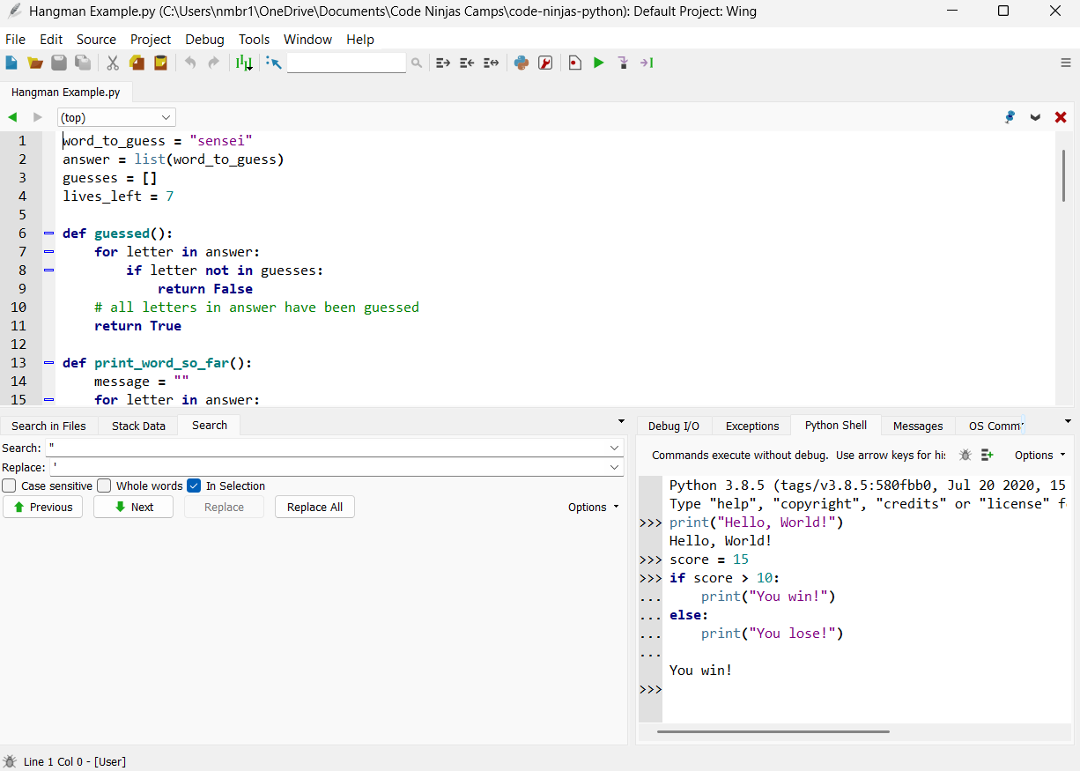
Click this button to open a file
Click this button to start the Python code!
Here is where we type our Python code!
Type Python code here to run it immediately!

Slide 7
Python Basics
Strings, integers, and the print statement

Slide 8
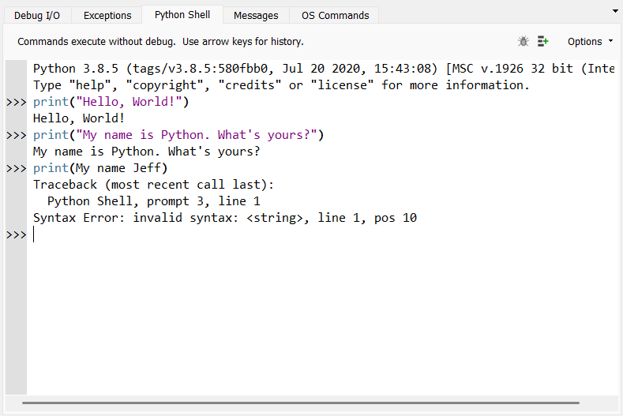
Hello, World!
To print something onto our screens, we need to use the print function.
We also need to put the text that we want to print between “quotation marks”
If we forget the “quotation marks”, we will get an error

Slide 9
Strings
“Hello, World!”
When we wrap text between “quotation marks”, we create something in Python called a string
A string is just a fancy word for text
Usually, the print function can only print strings
“Code Ninjas is the best”
“abc123xyz”

Slide 10
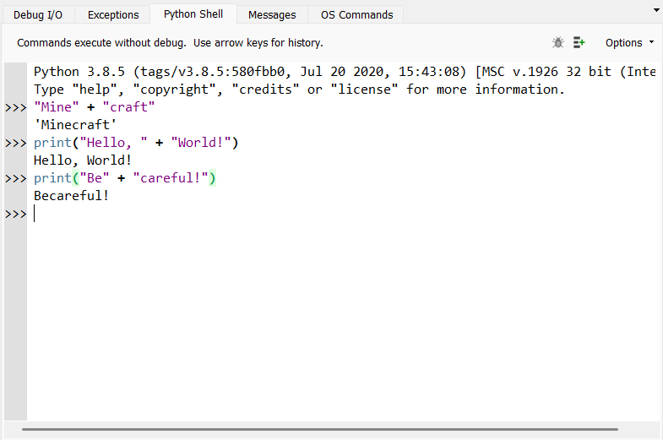
Combining Strings
To put two strings together, we can just put a plus sign (+) between the two strings!
You can also use a plus sign to put two strings together inside of a print function.
Be careful! When you’re combining two strings together, make sure you include a space at the end of the first string!

Slide 11
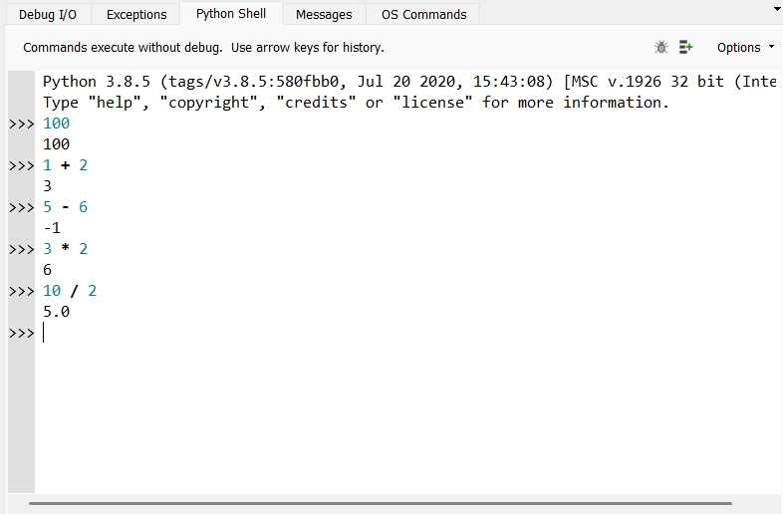
Integers
We can also use integers in Python!
Integer is just a fancy word for a whole number like 1, 15032, or -10.
With integers, we can do mathematical calculations like addition (+), subtraction (-), multiplication (*), and division (/).

Slide 12
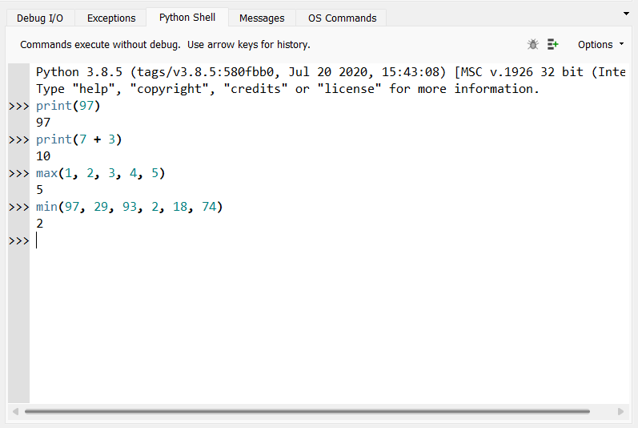
More About Integers
We can also print integers and entire mathematical operations with the print function.
We can find the maximum of a bunch of numbers by using the max function.
We can also find the minimum of a bunch of numbers by using the min function.

Slide 13
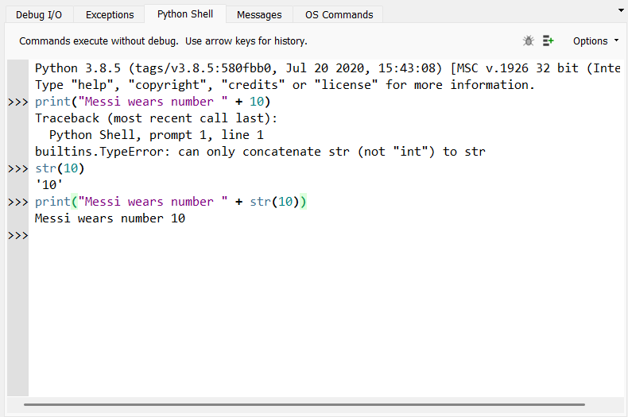
Combining Strings and Integers
If we try to combine a string and an integer by just putting a plus sign (+) between them, we get an error
To avoid this, we need to convert the integer to a string by using the str function on the integer
Now, we can put a plus sign between them and combine the string and integer!

Slide 14
Summary: Python Basics
Python has strings (“text”) and integers (whole numbers).
We can print both strings and integers on the screen using the print function.
We can combine strings using the plus sign (+)
We can do math on numbers using +, -, *, and /
We can combine strings and integers by converting the integer to a string first
str(50)

Slide 15
Variables
Assigning variables and how to use them

Slide 16
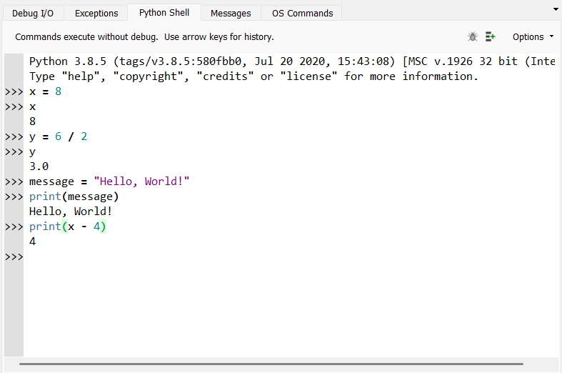
What are variables?
Variables are used to store data and give it a name so that we can use it later
They can store almost anything in Python, including strings, integers, lists, and Booleans
We can assign a value (or the result of a calculation) to a variable by using the equals sign (=)
Structure: variable = value

Slide 17
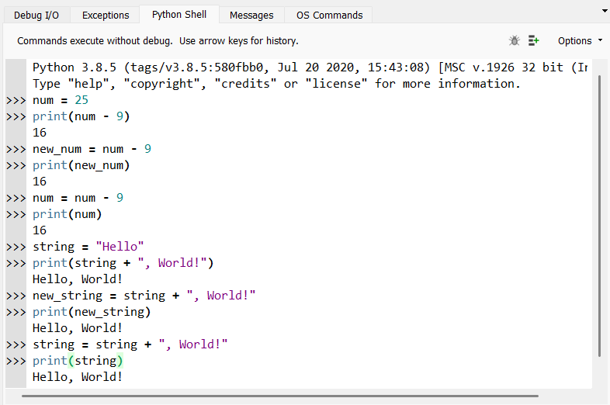
How can we use variables?
After assigning a variable, we can use it anywhere else in our program by using its name
You can use a variable to perform a calculation
You can use a variable to compute another new variable
You can also update variables by assigning it to a calculation with itself

Slide 18
Summary: Variables
Variables can store almost any type of data and give it a name so that we can use it later in our programs
We can assign a value or a computation result to a variable by using the equals sign (=)
variable = value
After assigning a variable, we can use it again in our program simply by using its name
We can use variables to perform computations, compute new variables, or update variables by assigning them to a computation that includes itself

Slide 19
Inputs
The input function, program customizations, and integer conversions

Slide 20
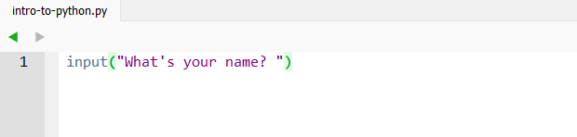
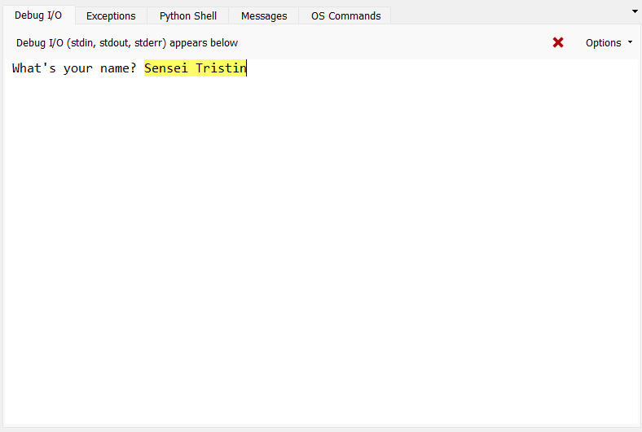
The input function
What if we want to get information from the user to use in our program?
We can use the input function!
We type the question or prompt that we want to ask inside the function.
When we run our program, this prompt will be printed on the screen for the user to answer.
Remember to include a space at the end of your prompt!

Slide 21
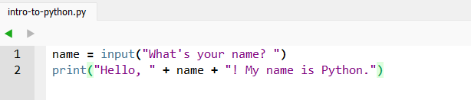
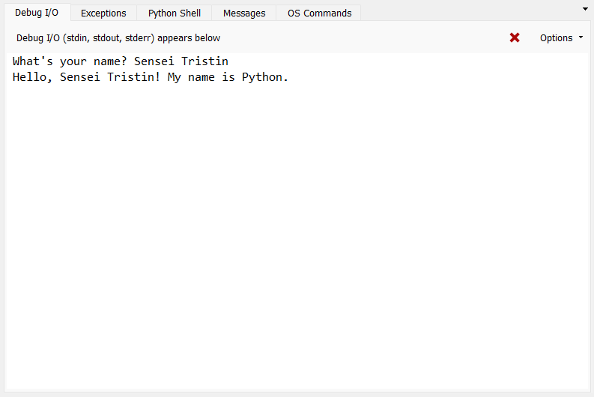
Storing and Using Inputs
Usually, we want to use player inputs in our programs. This can customize our program’s behaviour!
To use player inputs, store it into a variable by using an assignment.
After storing it into a variable, we can use that variable just like any variable that we’ve already learned about!

Slide 22
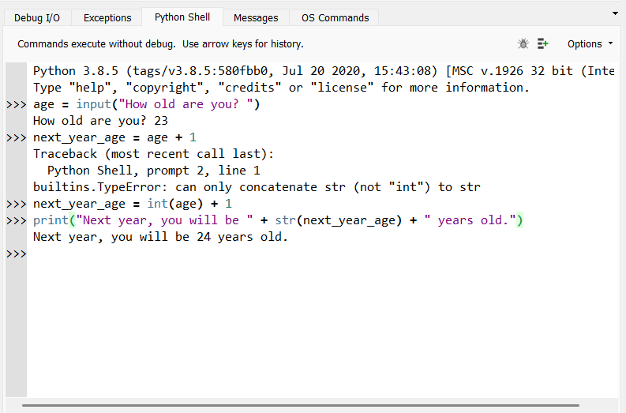
Number Inputs
We can also get number inputs from users.
However, we cannot use these inputs as numbers immediately! Inputs will always be stored as strings.
To use an input as a number, we need to convert the string into an integer by using the int function on the string.

Slide 23
Summary: Inputs
We can use the input function to ask the user to input that you can use to customize the behaviour of your program.
To use the player’s input, remember to store it in a variable!
If you want to use a number that your player inputted, remember to convert the input to an integer first by using the int function!

Slide 24
Project Time!
Mad Libs!

Slide 25
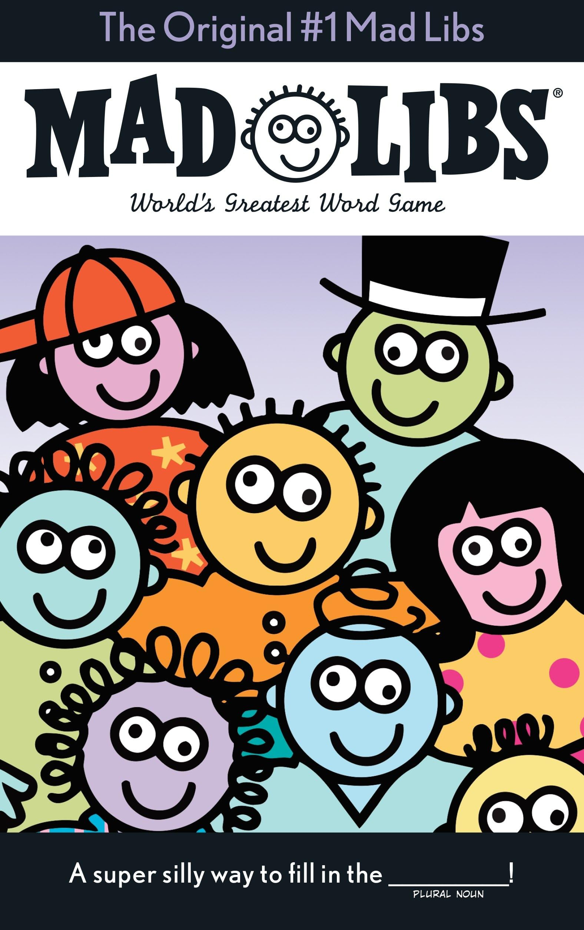
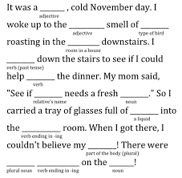
Mad Libs! Project
Provide details on how to open the Mad Libs! Project
We will use strings, integers, and inputs to create a Mad Libs project
Mad Libs are a fill-in-the-blank story. Most of the story is written already, but the player needs to answers prompts for specific types of words or numbers (like names, verbs, years, between 1 and 10, etc.)

Slide 26
Boolean Logic
True and False, number comparisons, connectors, and if-elif-else statements

Slide 27
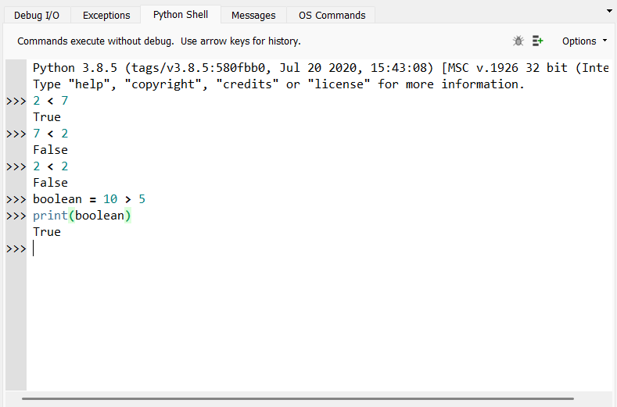
True or False?
Python also has another data type called a Boolean
This data type helps us decide if something is True or False
Booleans can only ever be True or False, nothing else!
We can also store a Boolean in a variable and print its value with a print statement

Slide 28
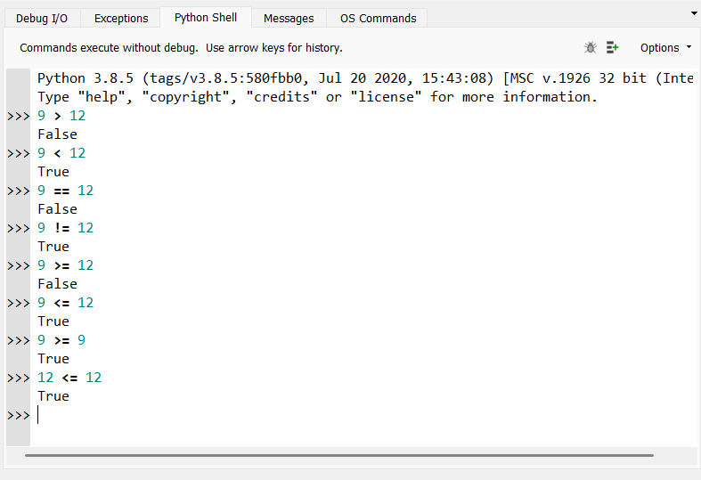
Comparing Numbers
We can compare numbers and variables storing a number by using number comparison operators:
> -- greater than
< -- less than
== -- equal to
!= -- not equal to
>= -- greater than or equal to
<= -- less than or equal to
Equal to (==) and not equal to (!=) can also be used to compare strings!

Slide 29
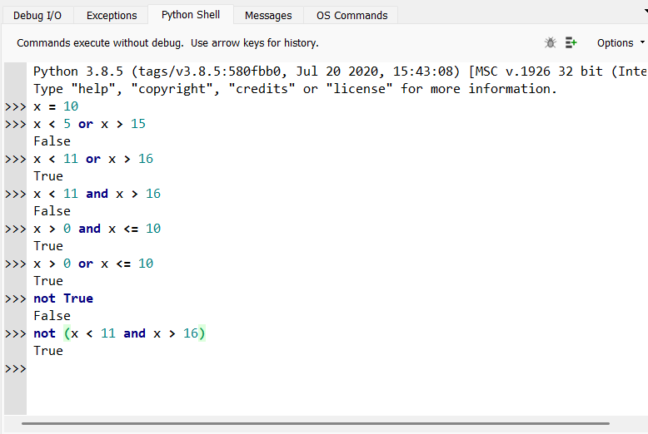
and, or, and not
We can also combine comparison statements with and and or to make a more complex comparison
and – is True only if both comparison statements are true
or – is True only if at least one comparison statement is true
We can also use not to change True to False, or change False to True

Slide 30
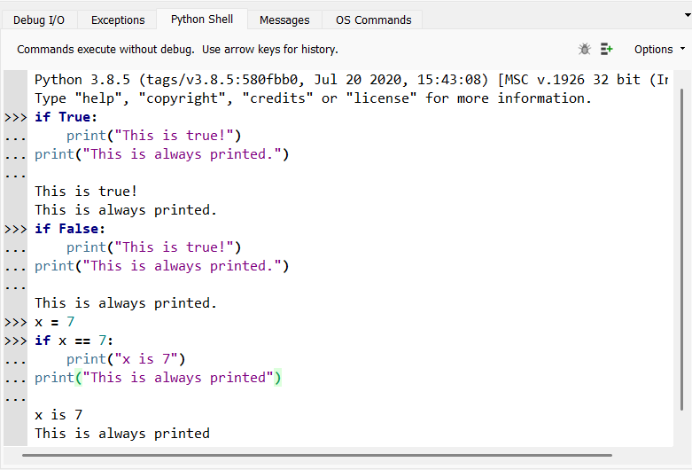
if statements
Booleans are typically used to control your program and tell it to do specific things depending on if they are True or False
An if statement is used to execute a section of code only if the provided Boolean statement is True
This statement can be a variable, number comparison, or any other computation that results in a Boolean

Slide 31
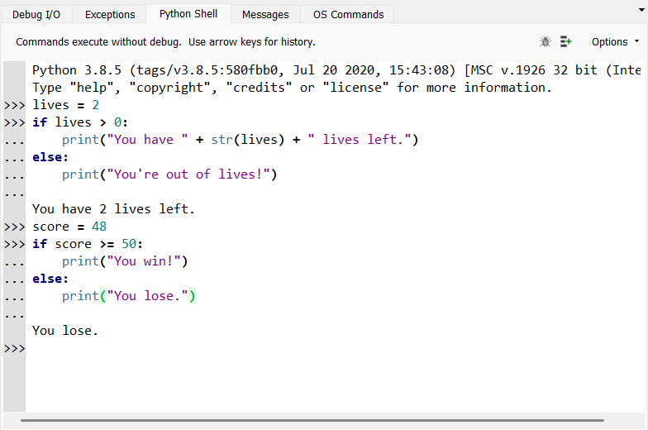
else statements
Sometimes, you may want to your code to do something if the condition in your if statement is False
For this, we can use an else statement with the if statement
The code in the else statement will execute only if the condition in the if statement is False

Slide 32
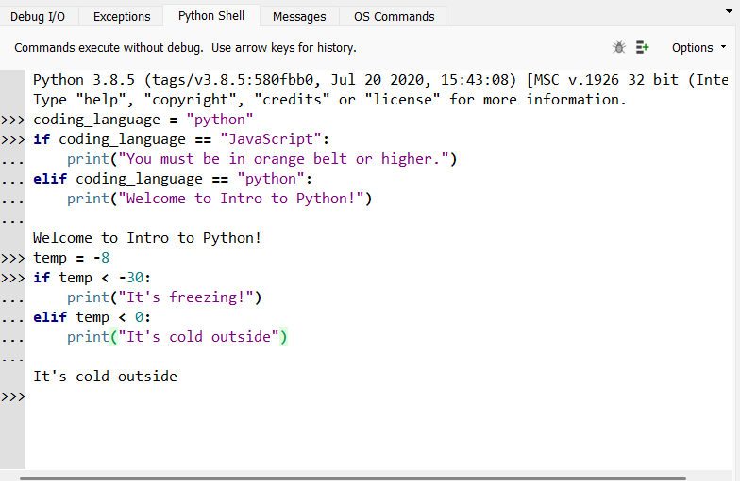
elif statements
What if you wanted to check another condition after your first if statement wasn’t True?
To check a new condition and execute different code if it is True, we can use an elif statement
elif is short for else if
The code in the elif statement will execute only if the condition in the if statement is False and the condition in the elif statement is True

Slide 33
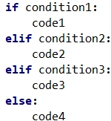
if-elif-else Statement Structure
elif statements only get checked if the if and all elif statements above it are False
code1 only executes if condition1 is True
You can use as many elif statements with an if statement as you want
code2 only executes if condition1 is False and condition2 is True
code3 only executes if condition1 and condition2 are False and condition3 is True
The else code runs only if the if and all elif statements are False
code4 only executes if condition1 and condition2 and condition3 are False
else statements can be used with if or elif statements, but aren’t needed

Slide 34
Summary: Booleans
Booleans represent values that can be either True or False
We can compare numbers with our six number operators to produce a Boolean
We can use equal to (==) and not equal to (!=) to compare strings
We can make more complex Boolean expressions by using and, or, and not
We can use Booleans to control the flow of our programs by using them as conditions in if-elif-else statements

Slide 35
Lists
List functions, indexing, and in

Slide 36
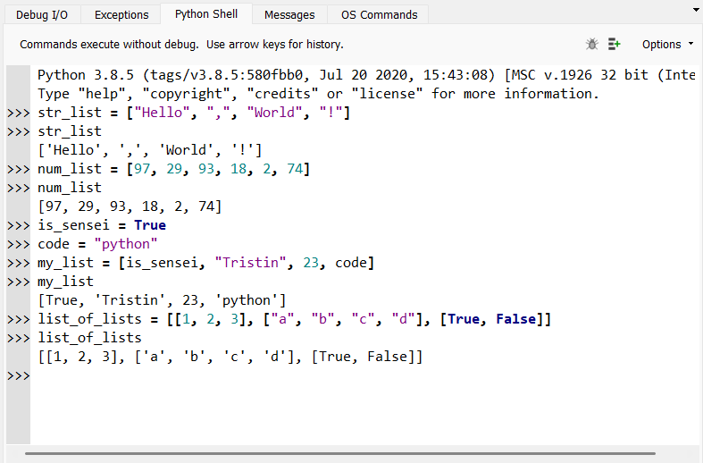
What are lists?
A list is something that can store a collection of values of data together inside of one ‘container’.
Lists are indicated by two [square brackets] that surround the elements that they are storing
List elements are separated from each other by a comma
Lists can store any type of data inside of them, including strings, integers, Booleans, and even other lists!

Slide 37
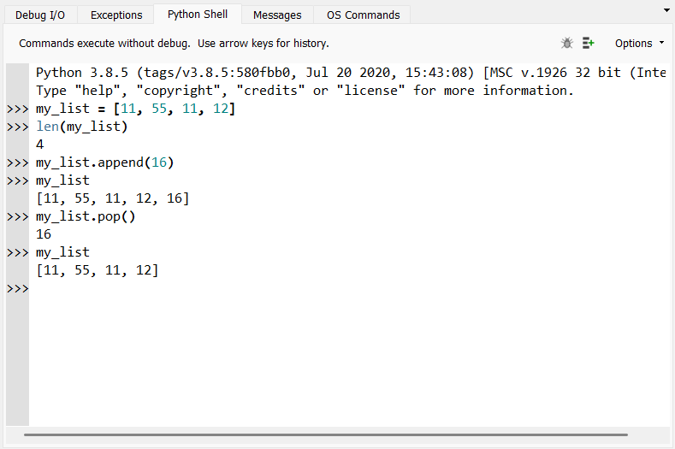
Common List Functions
Lists can have any number of elements! To check the number of elements in a list, we can use the len function.
To add something to a list, we can use the append function.
To remove the last element in a list, we can use the pop function. This function will also return the last element in the list
We will learn more about returning when we learn about functions later today

Slide 38
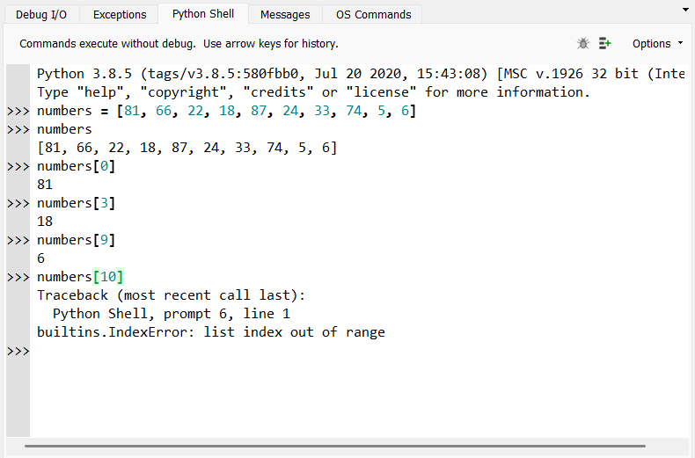
Indexing Lists
We can also get the elements that are in a specific position in a list. This is called list indexing
However, the positions of a lists are weird. Computers start counting from zero, so the first element has an index of 0, the second element has index 1, the third has index 2, and so on.
To index a list, we use the structure listname[index]

Slide 39
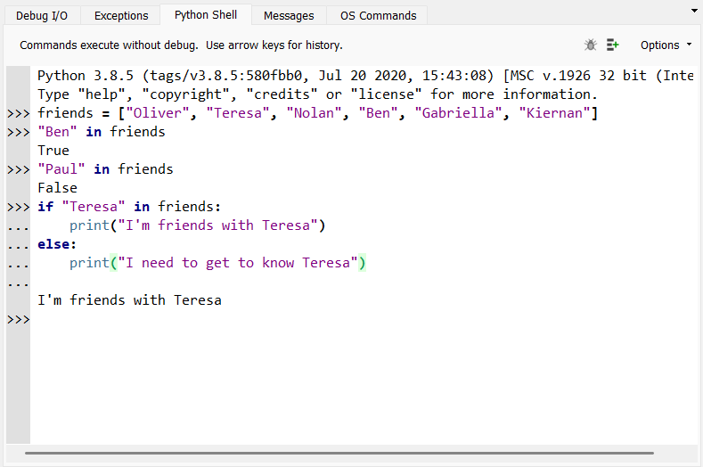
The in function
What if we wanted to check if a specific value was inside of one of our lists?
We can use the in function!
This function will generate a Boolean (True or False) value, so we can use it as a condition in an if-elif-else statement.
Structure: value in listname

Slide 40
Summary: Lists
Lists are used to store collections of elements inside of a single container
Lists are indicated by [square brackets], and elements in a list are separated by commas
You can use the len function to find the length of a list, the append function to add elements to a list, and the pop function to remove the last element of a list
We can get elements in a specific position in a list by using list indexing.
We can check if a specific value is in a list by using the in function.

Slide 41
Project Time!
Rock-Paper-Scissors

Slide 42
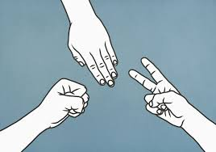
Rock-Paper-Scissors Project
Provide details on how to open the Rock-Paper-Scissors Project
We will use Booleans and lists to build a Rock-Paper-Scissors game!
Remember the rules of Rock-Paper-Scissors! Rock smashes scissors, scissors cuts paper, and paper covers rock.
If you have time, you can also try to create the Big Bang Theory game, Rock-Paper-Scissors-Lizard-Spock!

Slide 43
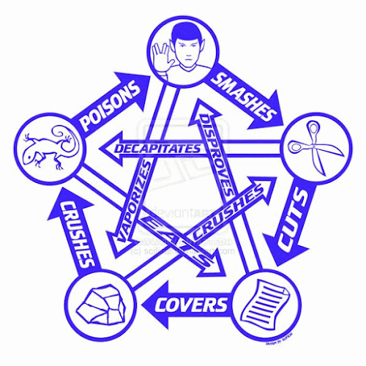
In Rock-Paper-Scissors-Lizard-Spock…
Scissors cuts Paper
Paper covers Rock
Rock crushes Lizard
Lizard poisons Spock
Spock smashes Scissors
Scissors decapitates Lizard
Lizard eats Paper
Paper disproves Spock
Spock vaporizes Rock
and, as it always has, Rock crushes Scissors

Slide 44
Loops
The range function, for loops, and while loops

Slide 45
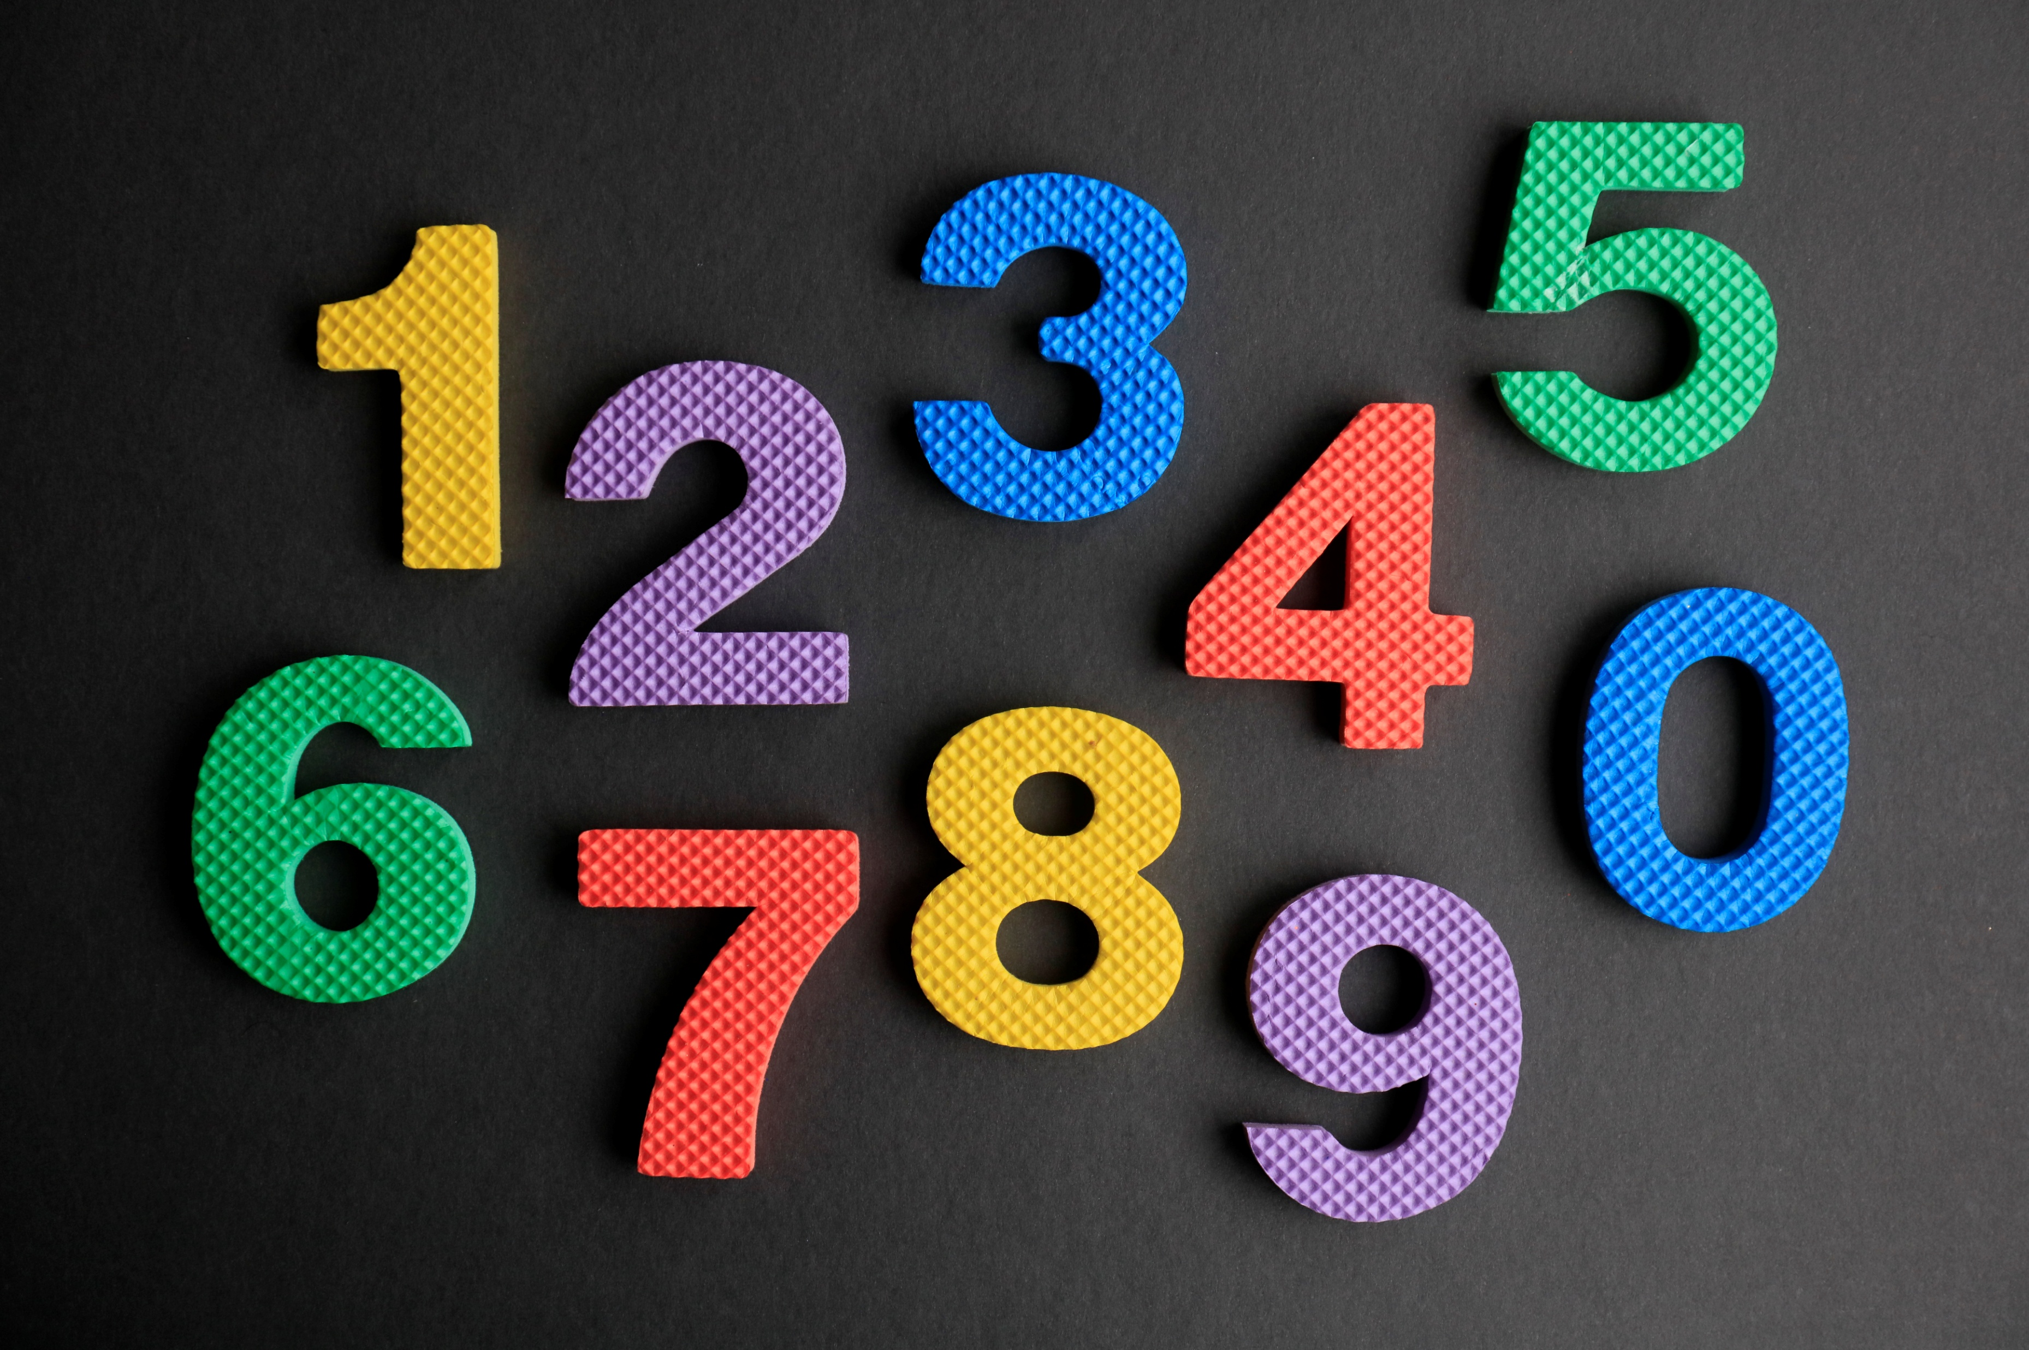
The range function
Before we discuss for loops, let’s discuss the range function
The range function can be used to generate a list of consecutive numbers, or numbers that appear in counting order
This range function is used extremely often in for loops
There are 3 different “versions” of the range function

Slide 46
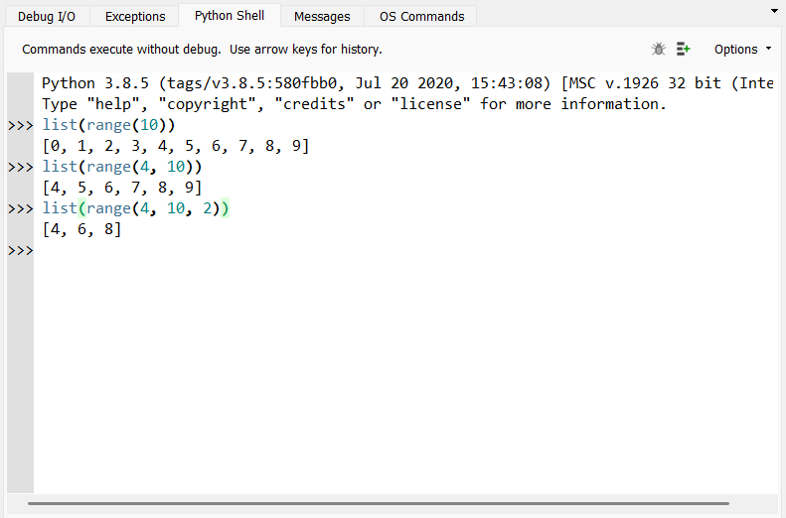
Versions of the range function
range(stop) – will generate a list of all numbers from 0 up to, but not including, the stopping number
range(start, stop) – will generate a list of all numbers from the starting number up to, but not including, the stopping number
range(start, stop, step) – will generate a list of numbers from the starting number, increasing by the stepping number each time, up to, but not including, the stopping number

Slide 47
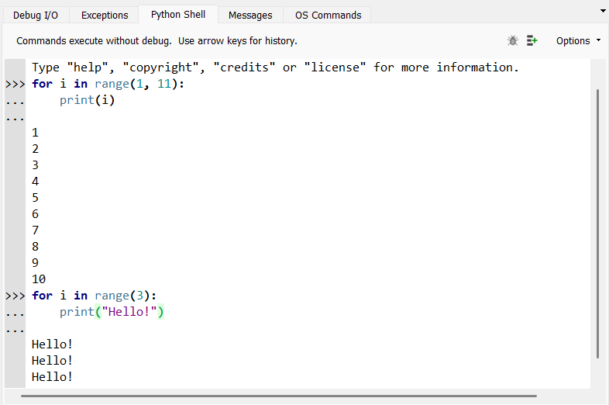
The for loop
A for loop can be used to execute a section of code a specific number of times
The for loop will execute the section of code one time for every element inside of a list or range that you want the for loop to go through
Usually, we use a range to execute the loop over a range of numbers
for variable in range:
code_to_repeat

Slide 48
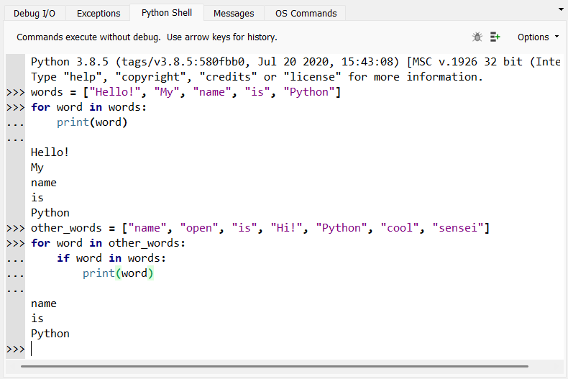
for item in list
You can also use a for loop to do something with every element in a list
The variable that you define with the for loop is assigned to each element that is in the list as the for loop goes through it
Use this variable inside the for loop to do something with the elements
for variable in list:
code_to_repeat

Slide 49
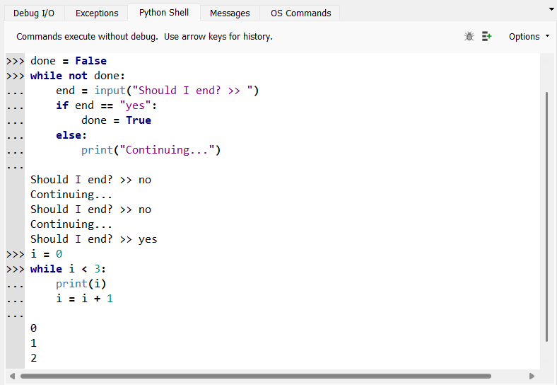
The while loop
A while loop can be used to execute a section of code an unknown number of times
The while loop will continue to execute the section of code until the Boolean condition defined with the loop is False
Make sure that our condition will eventually become False!
while condition:
code_to_repeat

Slide 50
Summary: Loops
The range function can be used to generate lists of consecutive numbers
3 formats: range(stop), range(start, stop), and range(start, stop, step)
The for loop can be used to execute a section of code a certain number of times
We can use for variable in range to execute the loop over a range of numbers
We can use for item in list to do something with each item in our list
The while loop can be used to execute a section of code an unknown number of times
The code will continue to execute until the while condition is False

Slide 51
Functions
Defining and calling functions, parameters, and return

Slide 52
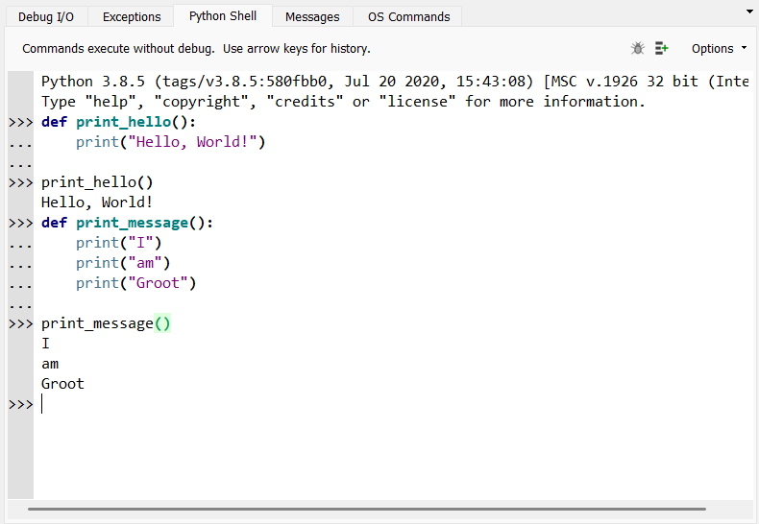
Using Functions
Functions are special sections of code that we give a name so that we can use them anywhere in our code!
To create a function, we define it by using the structure:
def function_name():
function_code
To use the function, we can call it by typing its name, followed by brackets, wherever we want to use it:
function_name()

Slide 53
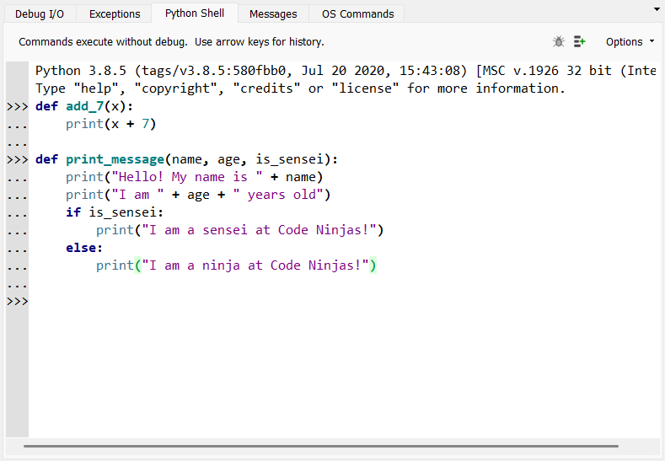
Function Parameters
We can give information to our functions to use by using parameters!
Parameters are a special type of variable that are defined with a function, and they can only be used inside the function they are defined in.
They are defined by including them in of the brackets of the function definition.
A function can have as many parameters as you want

Slide 54
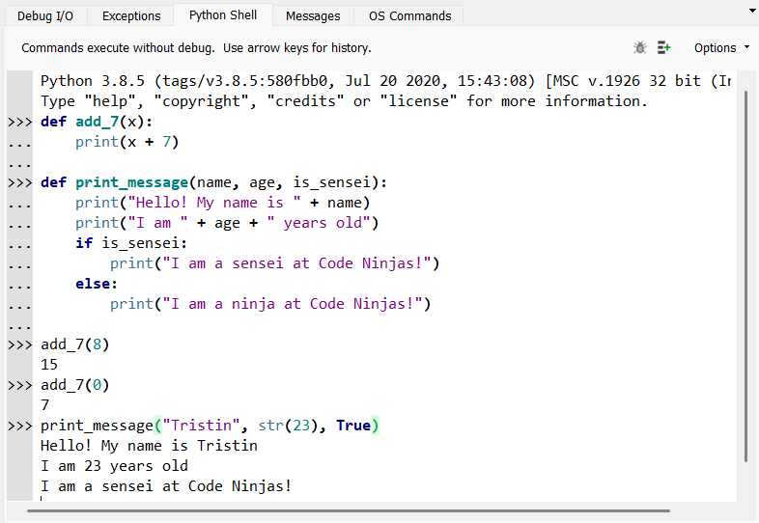
Arguments
Now that our functions can use the information we give them, how do we get this information to our function?
When we call our function, we give this information as arguments by typing it into the brackets in our function call.
When we provide these arguments, our parameter variables will be assigned to these argument values throughout the function code.

Slide 55
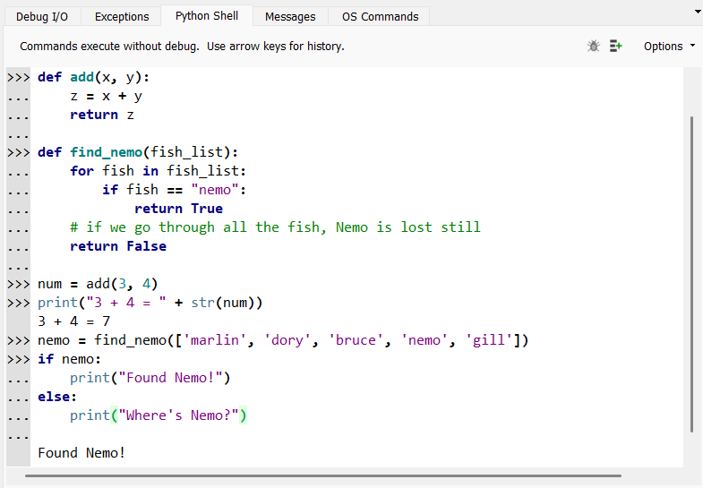
return Statements
Instead of just printing things, we can use a function to compute a value, then give that value to us with a return statement
A return statement is used to immediately end our function and give the value of a variable back to our code (kind of like an input statement)
Like an input statement, we usually assign the result of our function to a variable that we can use later in our code!

Slide 56
Summary: Functions
Functions are sections of code that we give a name that so that we can use and reuse them anywhere we want in our code
To use our function somewhere in our code, we have to call it
We define a function using def func_name():
Functions can use parameters, which are special variables that are defined with the function and can only be used inside the function it is defined for
Parameters are defined inside the brackets of a function definition
To assign values to the parameters, we give the function some arguments inside the brackets when we call the function
Our functions can also give a value back to our code by using a return statement

Slide 57
Final Project Time!
Calculator, Number Guesser, and Hangman

Slide 58

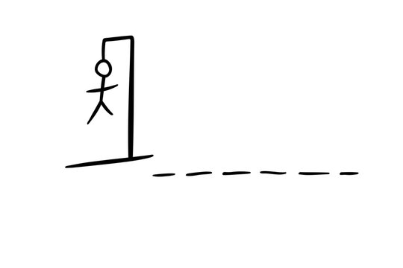
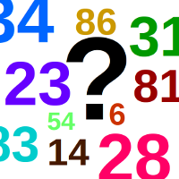
3 options to choose from!
Calculator
Number Guesser
Hangman
Build a calculator that can add, subtract, multiply, and divide. Players will be able to put in as many numbers as they want and can restart their calculation if needed.
The computer will randomly pick a number between 1 and 100 and the player will try to guess it! After each guess, the computer will say whether the actual number is higher or lower.
The classic Hangman word game! Players will try to guess a secret word by picking one letter at a time. But be careful! Too many wrong guesses, and the player will lose.

Slide 59
Thank You!
Hope you had a great time learning all about Python!
Make sure to take your stuff home with you!

